Slide 1
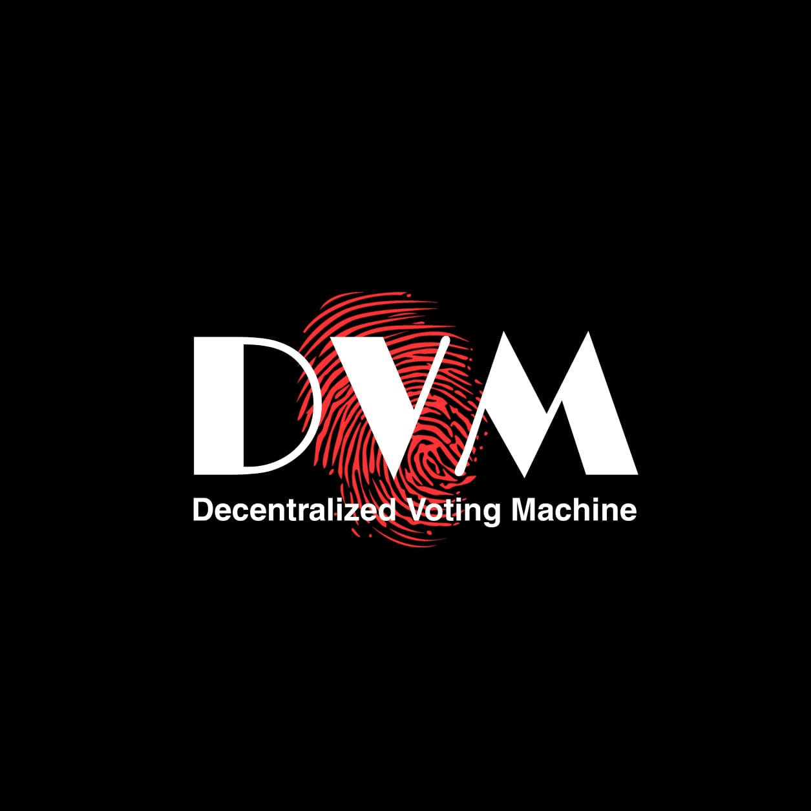

Slide 2
Existing System
The existing system of election is running manually.
The voter has to visit to booths to vote a candidate so there is wastage of time.
Due to this many people don’t go out to cast their votes which is a major problem considering how democracy works.

Slide 3
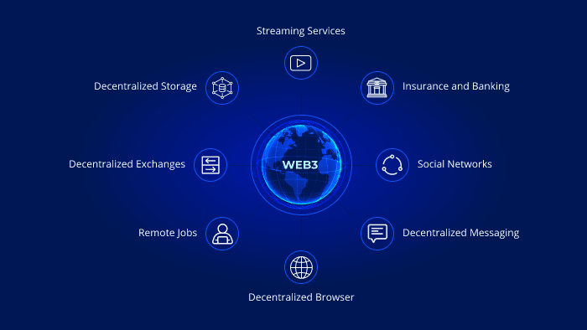
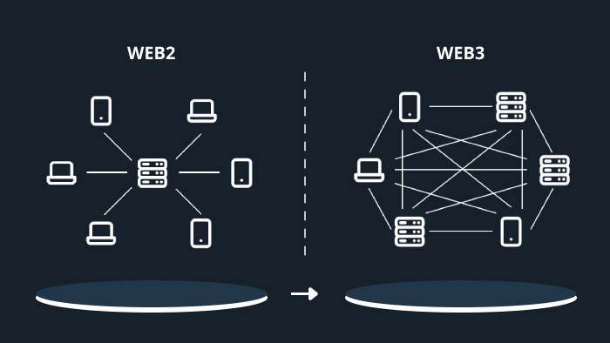
Web 3.0
Web3 (also known as Web 3.0) is an idea for a new iteration of the World Wide Web which incorporates concepts such as decentralization, blockchain technologies, and token-based economics.
Instead of a Web monopolized by large technology companies, Web3 embraces decentralization and is being built, operated, and owned by its users. Web3 puts power in the hands of individuals rather than corporations.

Slide 4
Blockchain
Blockchain can help to implement a system that is immutable, transparent, and efficient and cannot be hacked into.
A blockchain is a digital ledger or database where encrypted blocks of digital asset data are stored and chained together, forming a chronological single-source-of-truth for the data. Digital assets are distributed, not copied or transferred.
This system let’s user to anonymously vote for desired candidate.

Slide 5

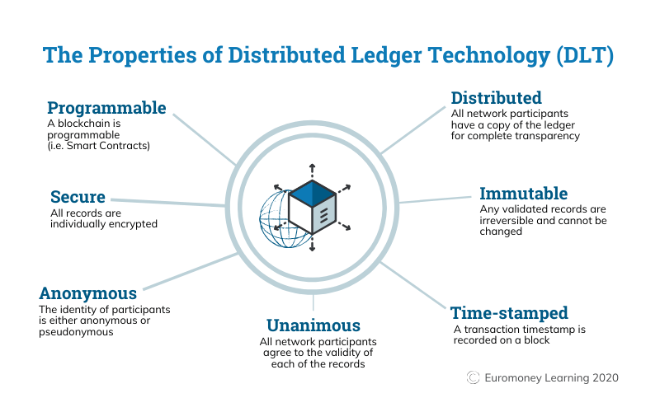

Slide 6
Advantages of DVM
Scalability : The internet voting system tends to maximize user participation, by allowing them to vote from anywhere and from any device that has an internet connection.
Security : One does not have the central authority; the data are stored in multiple nodes. It is not possible to hack all nodes and change the data. Thus, in this way, one cannot destroy the votes and efficiently verify the votes by tally with other nodes.

Slide 7
Efficiency : The reduction in organizational and implementation costs significantly increases the efficiency of election management compared to traditional paper voting .
Precision : The electronic vote eliminates errors in manual count, which brings with it an accurate and quick publication of results, with receipt of vote for each vote cast.

Slide 8
The whole project was divided into 2 phases
Phase 1 (Front-end for application) : In this phase we will cover the front-end module, in which we will build the interactive user-interface for the admin as well as the user.
Phase 2 (Back-end using Solidity) : In this phase we will cover the back-end module implementing the Blockchain using Ethereum framework and convert the system into a decentralized application.

Slide 9
Phase 1
a) Admin- The admin module is divided into 5 components
Dashboard : It will contain various charts to display information such as number of parties, number of voters etc.
Add Candidate : In this feature of admin, he can add candidates who are standing in the election. After candidate is added it will be displayed on the user side.
Create Election : This feature of admin will allow him to create election. A user can cast his vote only after the election is created by admin. A user can cast vote between the start date and end date.

Slide 10
Election Details : In this section admin can update election details such as start date, end date etc.
Candidate Details : In candidate details all the candidates added by admin will be displayed. Admin can update the candidate details if incase a wrong entry is done.
b) User- The user module is divided into 4 components.
Dashboard : The user dashboard contains information about parties and their candidates. A user can see all the information about candidate.

Slide 11
Voter Register : In this section first user will have to register himself only then he will be able to cast his vote.
Voting Area : After user is registered, then only he will be directed to this page and then he can cast his vote.
Results : In this component the user will be able to see the results of the election.

Slide 12
Phase 2
In this phase all the tech stack like NodeJS , solidity , hardhat are used for implementing the Blockchain using Ethereum framework and convert the system into a decentralized application.
NodeJS : It was used to define all the functionality of data, how the smart contract will interact through the application.
Solidity : It's used to create smart contracts that implement business logic and generate a chain of transaction records in the blockchain system. It acts as a tool for creating machine-level code and compiling it on the Ethereum Virtual Machine (EVM).

Slide 13
Hardhat : Hardhat is a Solidity development environment built using Node js. It consists of different components for editing, compiling, debugging and deploying your smart contracts and dApps.
Metamask : MetaMask is a decentralized, non-custodial Ethereum-based wallet that allows users to store, buy, send, convert, and swap crypto tokens. It allows users to access their Ethereum wallet through a browser extension or mobile app

Slide 14
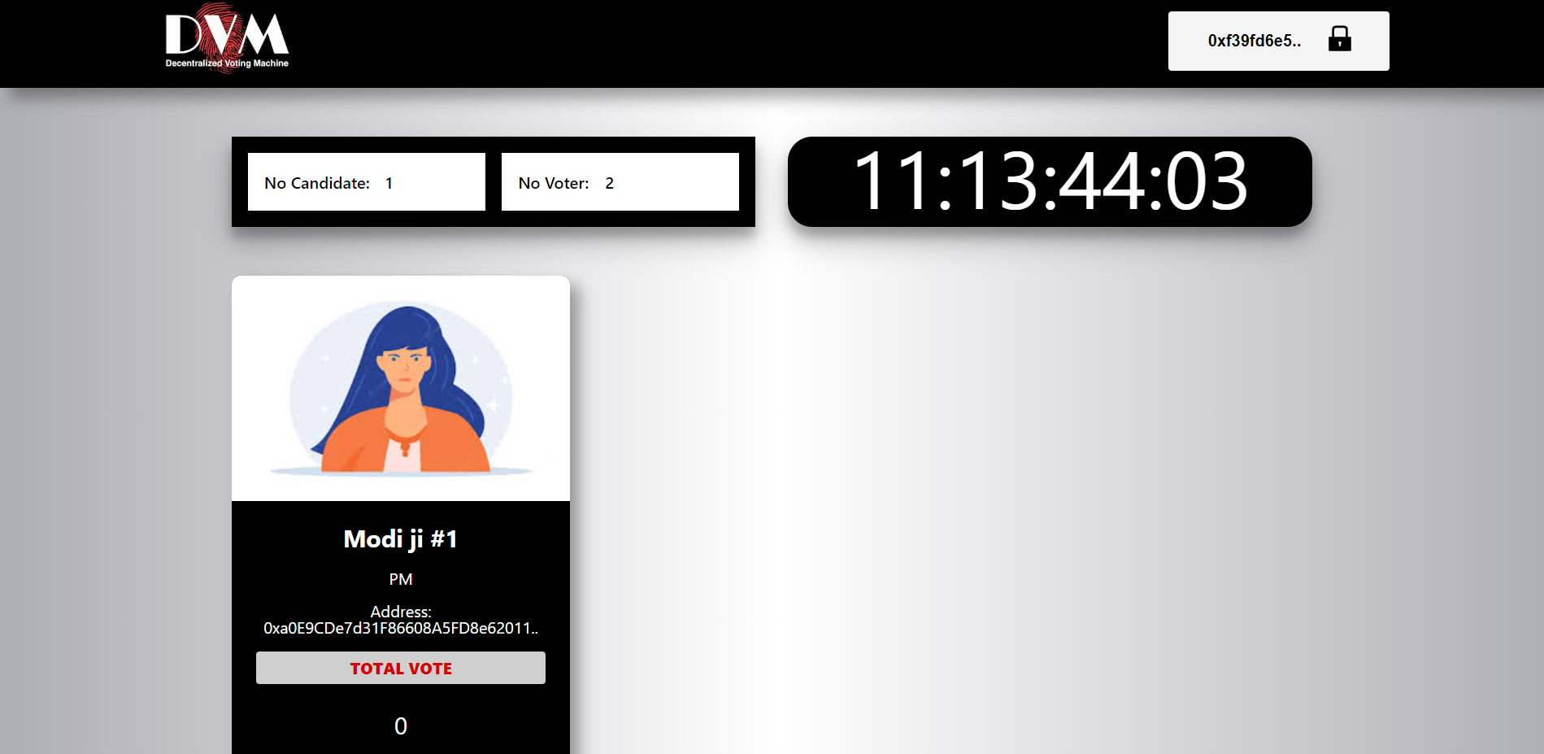
Glimpse
The following is the home page of the site. The main voting process is carried out here.

Slide 15
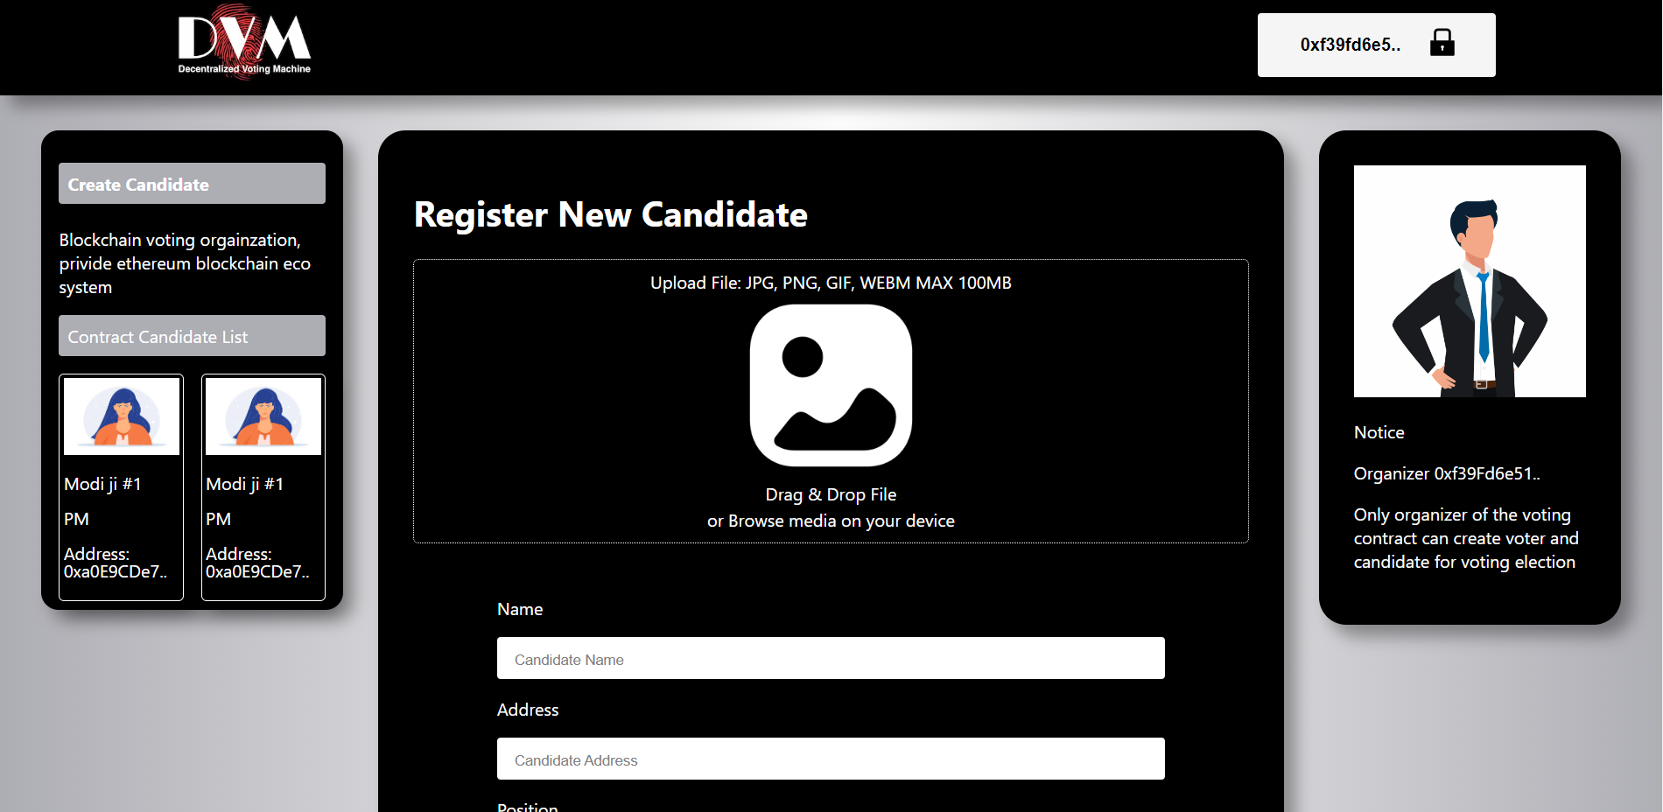
The following page helps the administrator to register the candidate for the election.

Slide 16
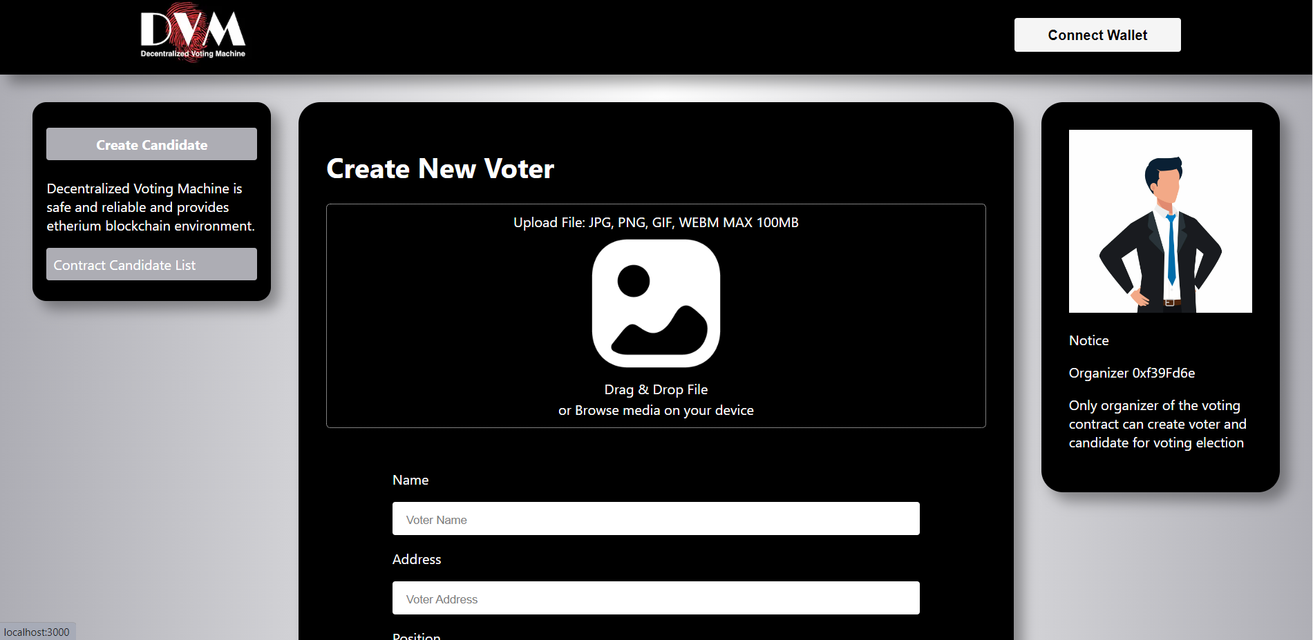
The following page helps the user to register himself/herself as a voter

Slide 17
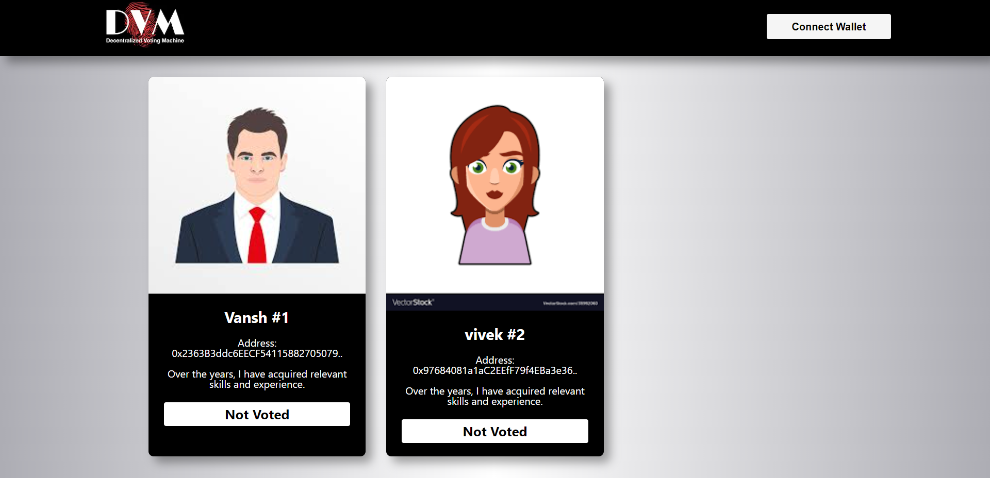
4.

Slide 18
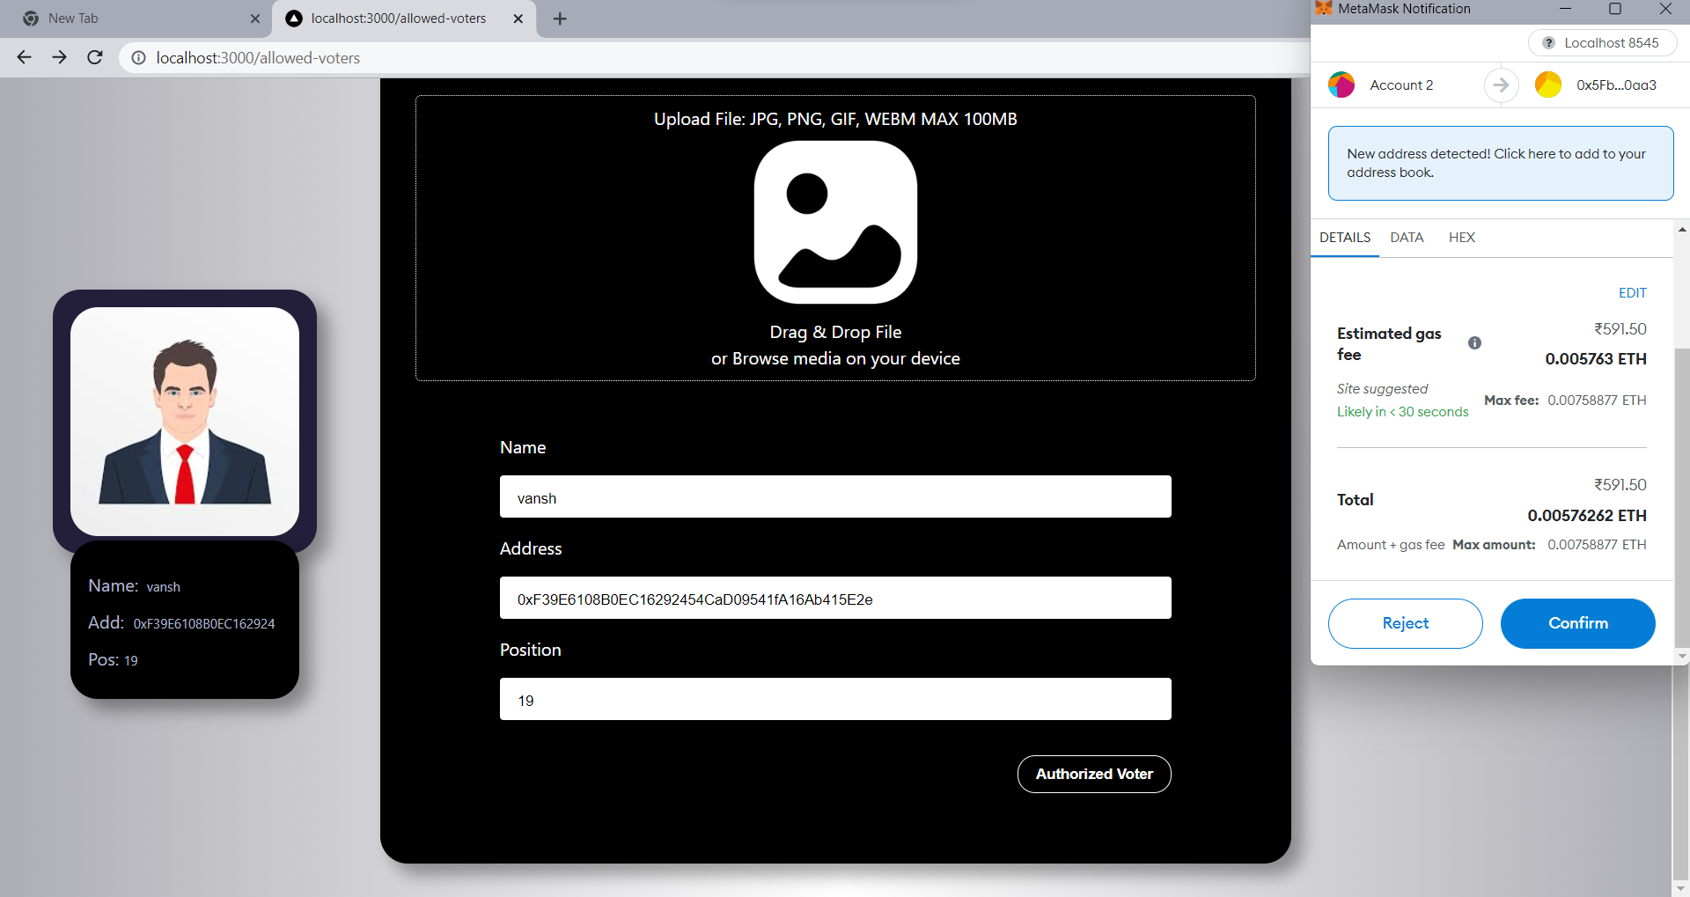
5.

